Slide 1
Email & Google Gmail

Slide 2
What’s email and why use it?
Email is short for Electronic mail - it is a fast, easy, and inexpensive way to communicate with family, friends, and colleagues.
Email messages are sent from one person to another via a computer or mobile device such as a phone.
Email is more professional than a text - it is used in business.
The email message typically contains text, but can also contain files, images, or music
2
Notes:
Differences between email and texting

Slide 3
Email Safety Tips
Always log off your email account and close the browser completely when using a public computer.
Don’t click on links in email unless you are certain of the url.
Don’t open files with the extension .exe, .zip, or .scr
Do not email anyone your bank account, social security number or credit card numbers
Remember not everything is true – hoaxes sent via email are very common.
Avoid Sweepstakes and Surveys.
Never buy from or reply to a Spam email.

Slide 4
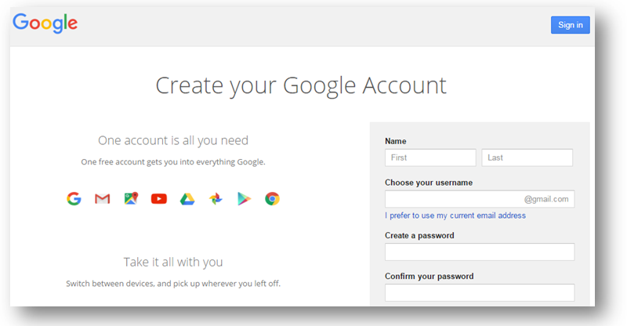
Google Account for Gmail
One account is all you need to access
Google Apps like Gmail
Select the link below to access the Website to create a Google account for Gmail™ email.
English: https://accounts.google.com/signup
Spanish: https://goo.gl/U5hx6H

Slide 5
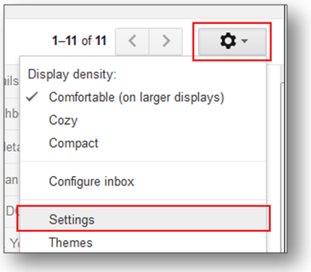
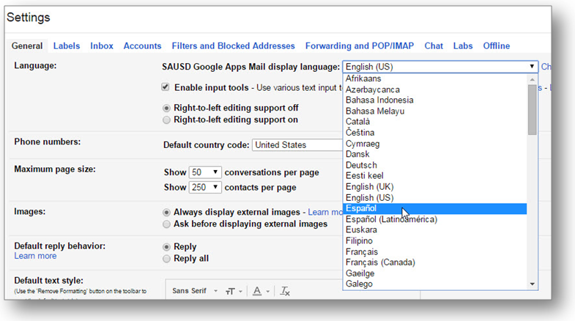
Gmail Language Option
Login to your Gmail
Select the Settings clog
Select Settings from the dropdown menu
Select Espaňol
Notes:
In order to change from English to Spanish, have the users click on settings and Gmail display language

Slide 6
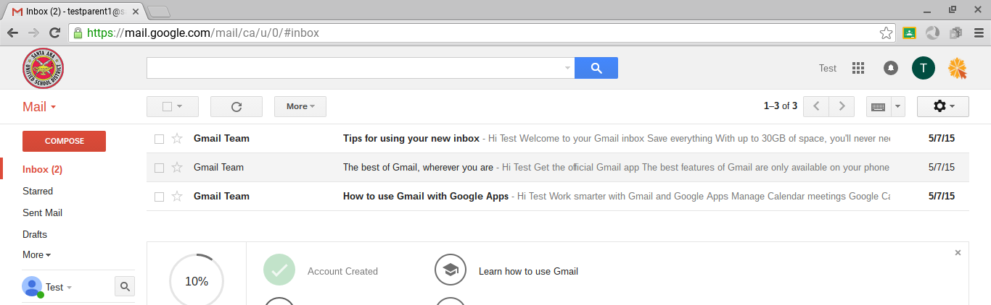
Getting Around Gmail
Inbox Sent Mail Drafts Compose
Click on message to open and read
Video Link for Gmail: Understanding where your messages go
Notes:
Your in-box is the folder where all your mail arrives. Click on a message to open and read it.
Your sent mail show you which emails you’ve sent to other people
Your drafts saves copies of email that you have written but not sent to anyone yet
Click compose to write a new email.

Slide 7
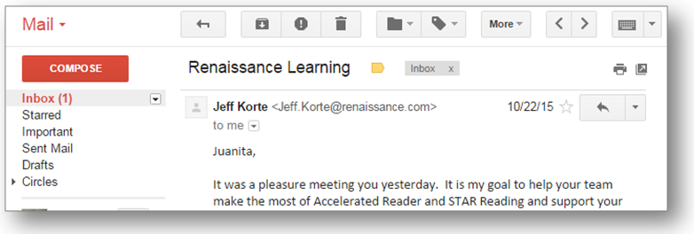
Replying to a Gmail
Open the email you wish to send a reply.
Select the “reply” arrow in the top right corner.
Gmail automatically fills in the person’s email address.
Type your message and click send.
Reply Arrow
Notes:
Instructor - let students walk through the steps

Slide 8
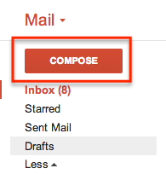
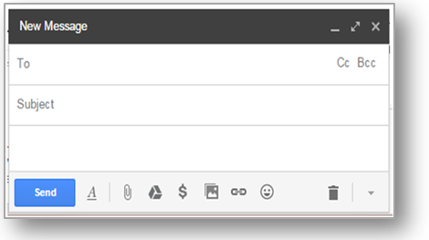
Composing an Email in Gmail
Think before you send. Like any digital material, emails can easily be forwarded.
Avoid discussing emotional issues over email.
Avoid using ALL CAPS. This is interpreted as yelling.
Notes:
Explain that clicking the Compose button opens a new email

Slide 9
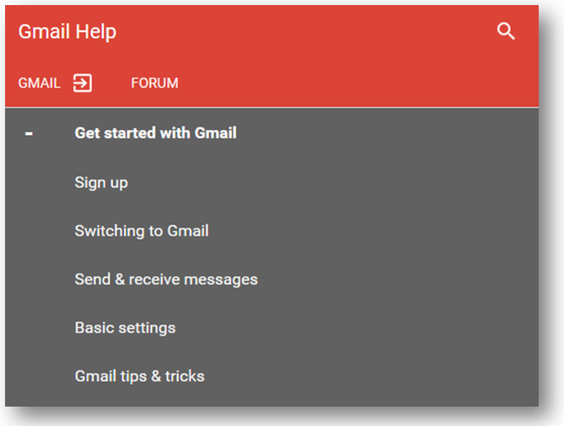
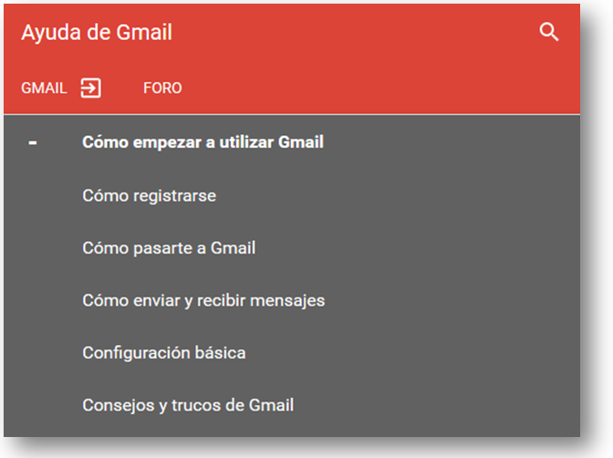
Gmail Support
https://goo.gl/88Wtks
https://goo.gl/2mRxuH

Slide 10
Notes:
Ask if there are any questions or comments.

